Slide 1


LUDWIG-
MAXIMILIANS-
UNIVERSITÄT
MÜNCHEN
Collaborative Software Development:
Intermediate Report
Group D:
- Jonas Biechteler (Speaker)
- Ngoc Toan Nguyen
- Liang Qiao
- Richard Stiskalek
Dec 21st 2020

Slide 2
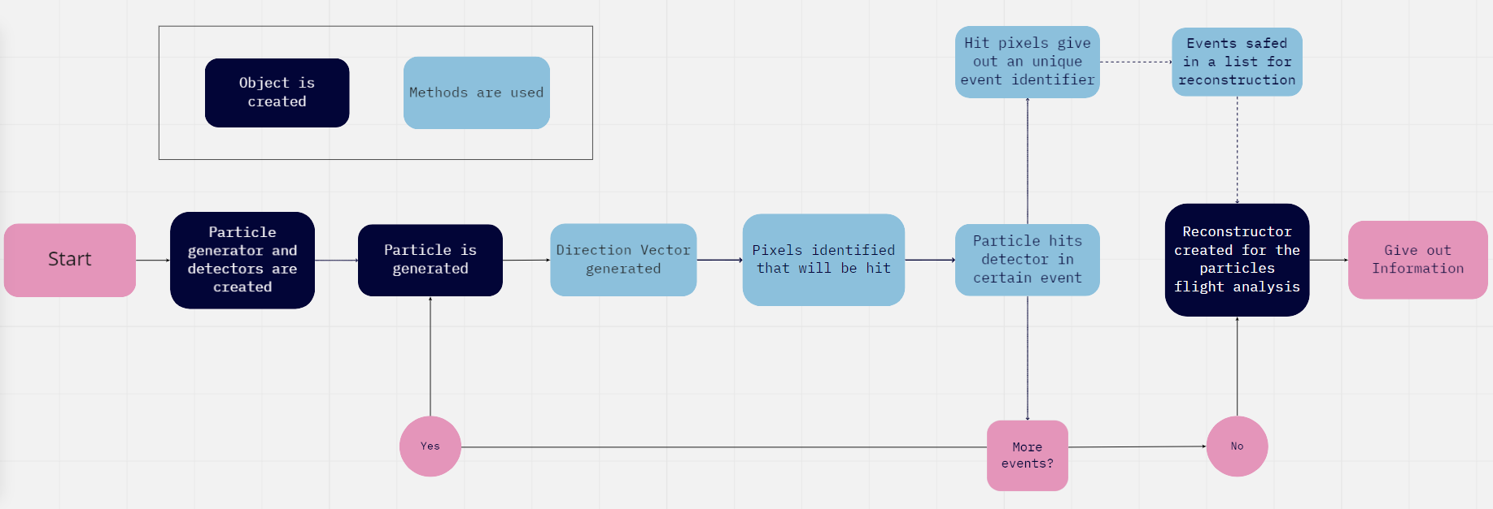
LUDWIG-
MAXIMILIANS-
UNIVERSITÄT
MÜNCHEN
Design
Object-oriented:
Generator (object): Generates random vectors in a cone. | Detector (object): Consists of pixels, that detect passing particles and store the information. | Particle(object): Moves in direction of generated vector. | Reconstructor(object): Uses the collected data to reconstruct the particles flight.
# 1
Group D: Richard Stiskalek, Ngoc Toan Nguyen, Liang Qiao, Jonas Biechteler (Speaker)

Slide 3
LUDWIG-
MAXIMILIANS-
UNIVERSITÄT
MÜNCHEN
Status of the project
Already running:
Simplified version of the simulation, with tested (Pytest) versions of the generator and detector classes.
Still in progress:
Event reconstruction. Methods for vector reconstruction of a single particle in test, but no algorithm for multible particles yet.
Open questions:
How to handle large amount of data, whithout recreating wrong vectors?
from setup import *
from simulator import (Generator, Detector)
generator = Generator(theta_max) # theta_max = 10
detector = Detector(boundaries, Npixs, z0) # detector geometry
# generation of N=1 particles:
events = generator.generate(N=1)
# detection of the particles
detections = [detector.evaluate_collision(event) for event in events]
print(detections)
[{'xpixel': 642, 'ypixel': 1053, 't': 30.21724065105107, 'z': 30}]
# 2
Group D: Richard Stiskalek, Ngoc Toan Nguyen, Liang Qiao, Jonas Biechteler (Speaker)

Slide 4
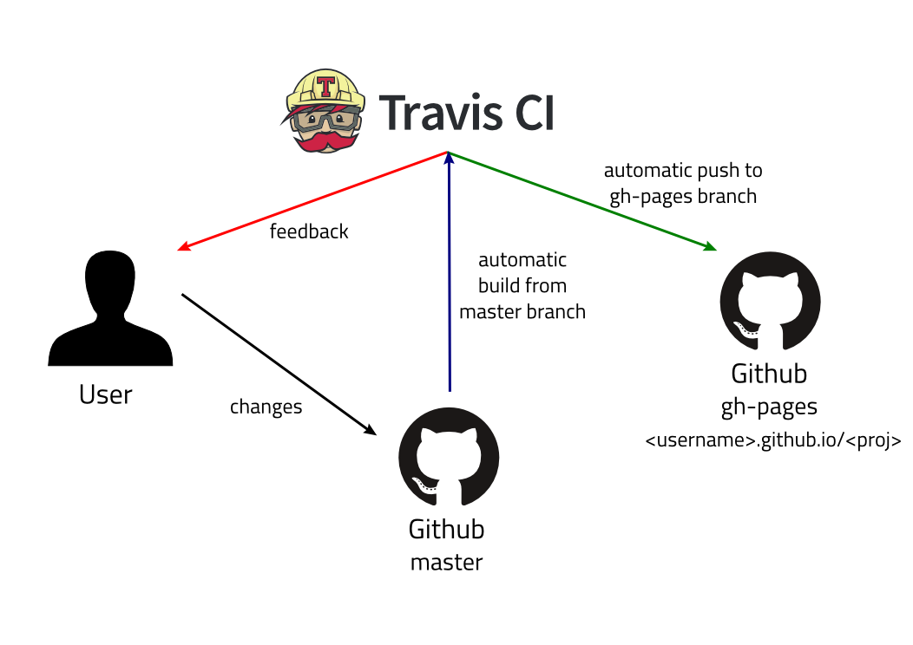

LUDWIG-
MAXIMILIANS-
UNIVERSITÄT
MÜNCHEN
Further Plans
Finish reconstructor class, while keeping independency to other parts of the program.
Get closer to reality: Implement broken pixels, undetected events, random speed and origin for particles, …
Implement further changes in the project‘s requirements.
Integration tests
Make everyones life easier: make use of continous integration service Travis CI and Codacy (code review service), wich we just got running.
www.freecodecamp.org/news/learn-how-to-automate-deployment-on-github-pages-with-travis-ci/
# 3
Group D: Richard Stiskalek, Ngoc Toan Nguyen, Liang Qiao, Jonas Biechteler (Speaker)

Slide 5

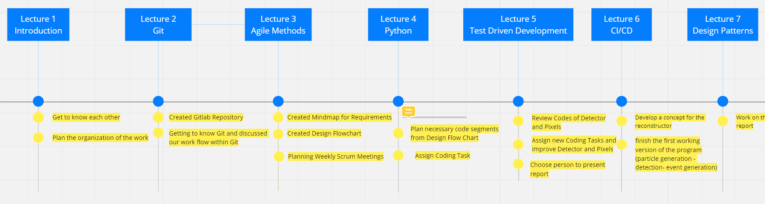
LUDWIG-
MAXIMILIANS-
UNIVERSITÄT
MÜNCHEN
Organization of work
Scrums: Weekly meetings at Monday (planning) and Saturday (reviewing). | Sprints: Small tasks from Monday to Monday, talking about progress and problems on Saturdays.
Miro.com
Scrum documentation (Miro.com).
# 4
Group D: Richard Stiskalek, Ngoc Toan Nguyen, Liang Qiao, Jonas Biechteler (Speaker)

Slide 6
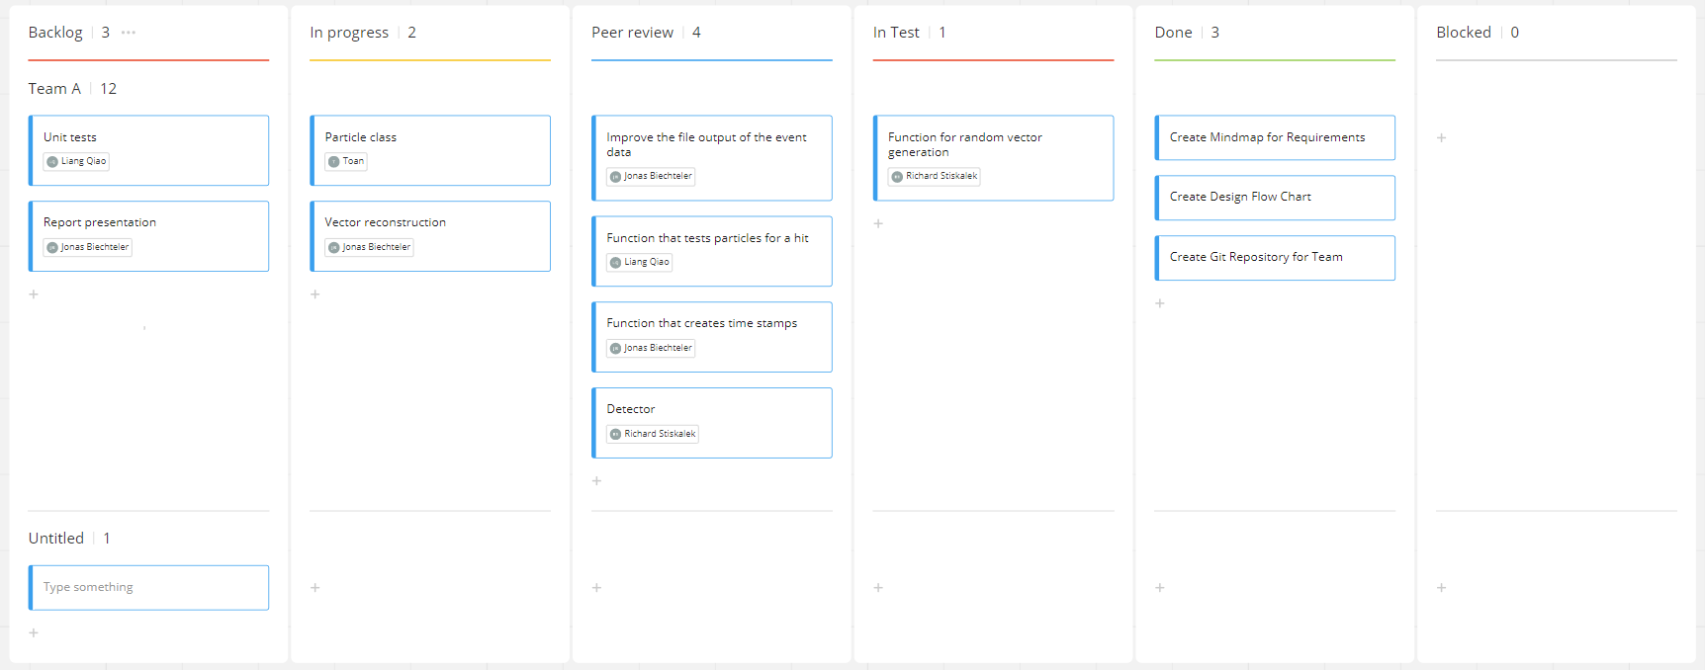
LUDWIG-
MAXIMILIANS-
UNIVERSITÄT
MÜNCHEN
Organization of work
Keep it as agile as possible for our small group!
➔ Parallel work on whatever a person has ideas for.
Kanban board of the goup (Miro.com).
# 5
Group D: Richard Stiskalek, Ngoc Toan Nguyen, Liang Qiao, Jonas Biechteler (Speaker)

